Slide 1

BACHELOR OF ARTS IN VALUES & SPIRITUAL EDU.
(Under ‘Yash-Brahma’ Project )
BRAHMA KUMARIS EDUCATION WING, RE & R F
InTechinical Collaboration with
Yashwant rao Chavan Maharashtra Open University, Nashik

Slide 2
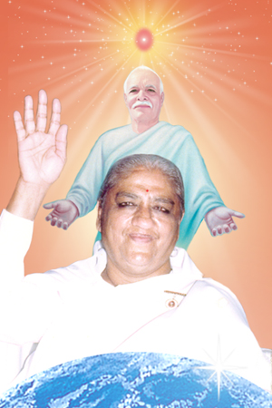
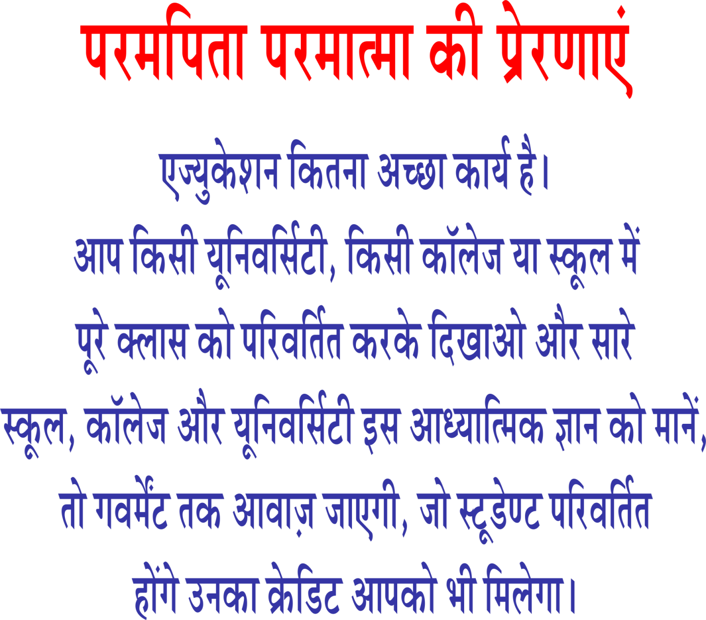

Slide 3
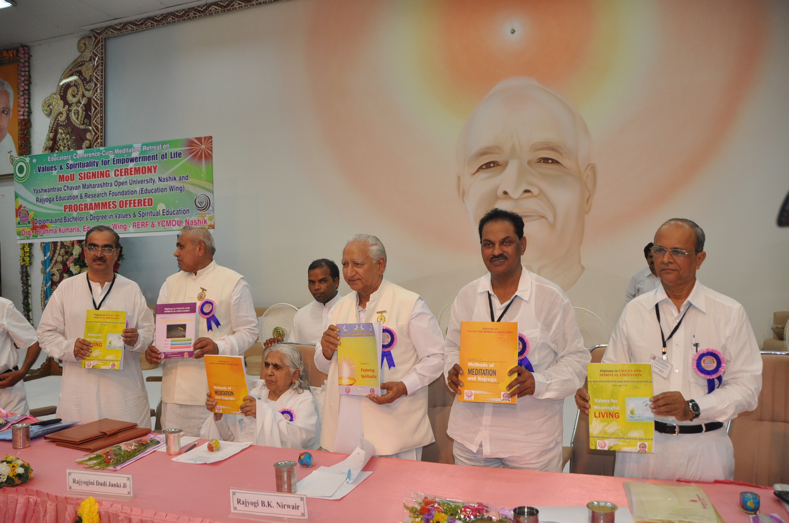
Memorandum Of Understanding
3rd September,2012

Slide 4
Yashwantrao Chavan Maharashtra Open University, Nashik

Slide 5




Slide 6
BRIEF INTRODUCTION
Brahma Kumaris institution was founded by Brahma Baba in the year 1936 at Karachi and he served the institute ceaselessly till his last breath in the year 1969 at the age of 93.
During the year 1950, the Head Quarter of the institute was moved from Karachi to Mount Abu in Rajasthan, India.
After Brahma Baba, Dadi Prakashmaniji served as the Administrative Head of the institute world wide until she left her body on 25th August 2007.
Presently the institute is administered by Dadi Jankiji, Dadi Hridayamohiniji and Dadi Ratanmohiniji.
Brahma Kumaris is an international institute with around 9000 branches in over 137 countries which are functioning with the aim of creating a world of peace and harmony.

Slide 7
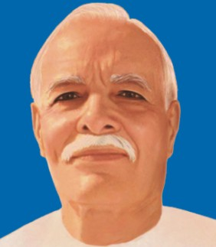
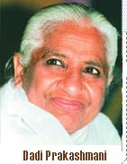
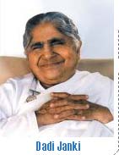
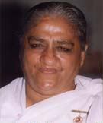
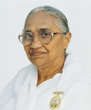
Founder
Administrator
Dadi Prakashmani
Brahma Baba
Present Administrators
Dadi Jankiji
Dadi Hridaymohiniji
Dadi Ratanmohiniji

Slide 8

OBJECTIVE
Promoting…
World Transformation
through
Self Transformation
for a
peaceful and prosperous
World

Slide 9
Programs offered
S. N | Program | Eligibility | Duration
1. | Diploma in Values & Spiritual Education ( 1st year of B.A in V& SE ). | +2 or Preparatory Pass (Course Fee-Rs. 3000) | One Year (2013-14)
2 | Advance Diploma in Values & Spiritual Education ( 2nd Year of B.A. in V&SE) | . Diploma in Values & Spiritual Education | One Year (2014-15)
3 | Bachelor of Arts in Values & Spiritual Education (3rd Year of B.A. in V&SE) | Advance Diploma in Values & Spiritual Edu. | One Year (2015-16)

Slide 10

Diploma in Values & Spiritual Education
(First Year of B.A. in V& SE)
Medium: Hindi / English/Marathi
Subjects of Study
Foundation Course in Self Study Skills
Foundation Course in Hindi & English
Methods of Meditation & Rajyoga
Values for Meaningful Living
Exploring Spirituality
Practical-Consistent Spiritual Progress

Slide 11

Advance Diploma in Values & Spiritual Education
(Second Year of B.A. in V & SE)
Medium: Hindi / English/Marathi
Subjects of Study
Personality Development
I & My Social Behavior
Environmental Awareness
Values for Successful Living
Principles of Purposeful Living
Practical- Personal Progress

Slide 12
Bachelor of Arts in Values & Spiritual Education
(Third Year of B.A. in V & SE )
Medium: Hindi / English/Marathi
Subjects of Study
1. Soft Skills
2. Major Religions and the Divine
3. Healing Relationships
4. Spiritual Lifestyle
5&6. Project-Field Study

Slide 13
Compulsory Personal Contact Program
S. No. | Program | Max. Days | Min. Days
1 | Diploma in Values & Spiritual Education ( 1st year of B.A in V&SE. | 10 | 8
2 | Advance Diploma in Values & Spiritual Education ( 2nd Year of B.A. in V&SE) | 10 | 8
3 | Bachelor of Arts in Values & Spiritual Education ( 3rd Year of B.A.in V&SE | 12 | 10

Slide 14
ADMISSION PROCEDURE
Student should collect Prospectus along with Bank Challan from recognised study center.
He should carefully fill in the admission form in Bold English Letters without overwriting
He should obtain signature & seal of the study center.

Slide 15
He should deposit fees of Rs. 2000 along with Bank Challan in any one of Banks specified in the challan
5. First part of the challan will be retained by the bank, Second part will be deposited to study center along with Admission form and third part will be retained by the student
6. Students should retain photocopy of Admission Form for future reference

Slide 16
Diploma in Values & Spritual Education
( First year of B.A.in V&SE )
KEEP IN MIND
ELIGIBILITY : +2 or Preparatory Pass
COURSE FEE : Rs 3000/-
LAST DATE : 31st july.,2013
EXAMINATION : Regular Examination in May

Slide 17
DURATION : One academic year
(1st July 2013 to 30th June 2014).
PCP :Personal Contact Program of 10 days
(8 days attendance is compulsory).
AGE :18 Years at the time of Admission
LANGUAGES :English/ Hindi / Marathi

Slide 18

Om Shanti
Dr R P Gupta
HQ Co-ordinator, DEP, Mount Abu

